Slide 1
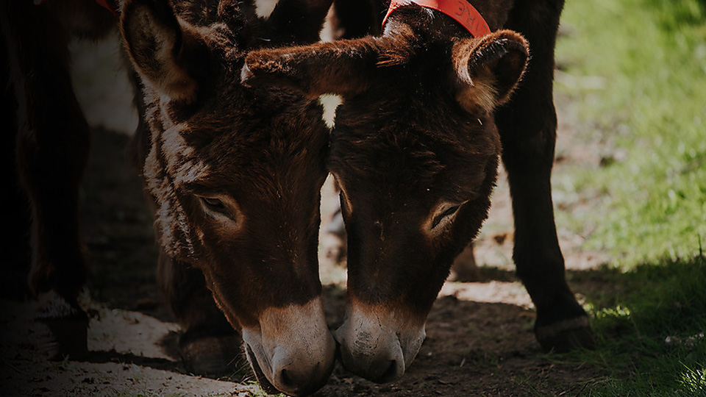

Delivering the Sustainable Development Goals
The role of working equids and the threat of the donkey skin trade
Ian Cawsey
Director of Advocacy & Campaigns
The Donkey Sanctuary
7th Sep 2020 Africa Animal Welfare Conference
Notes:
Right click and format background to change image

Slide 2


Slide 3
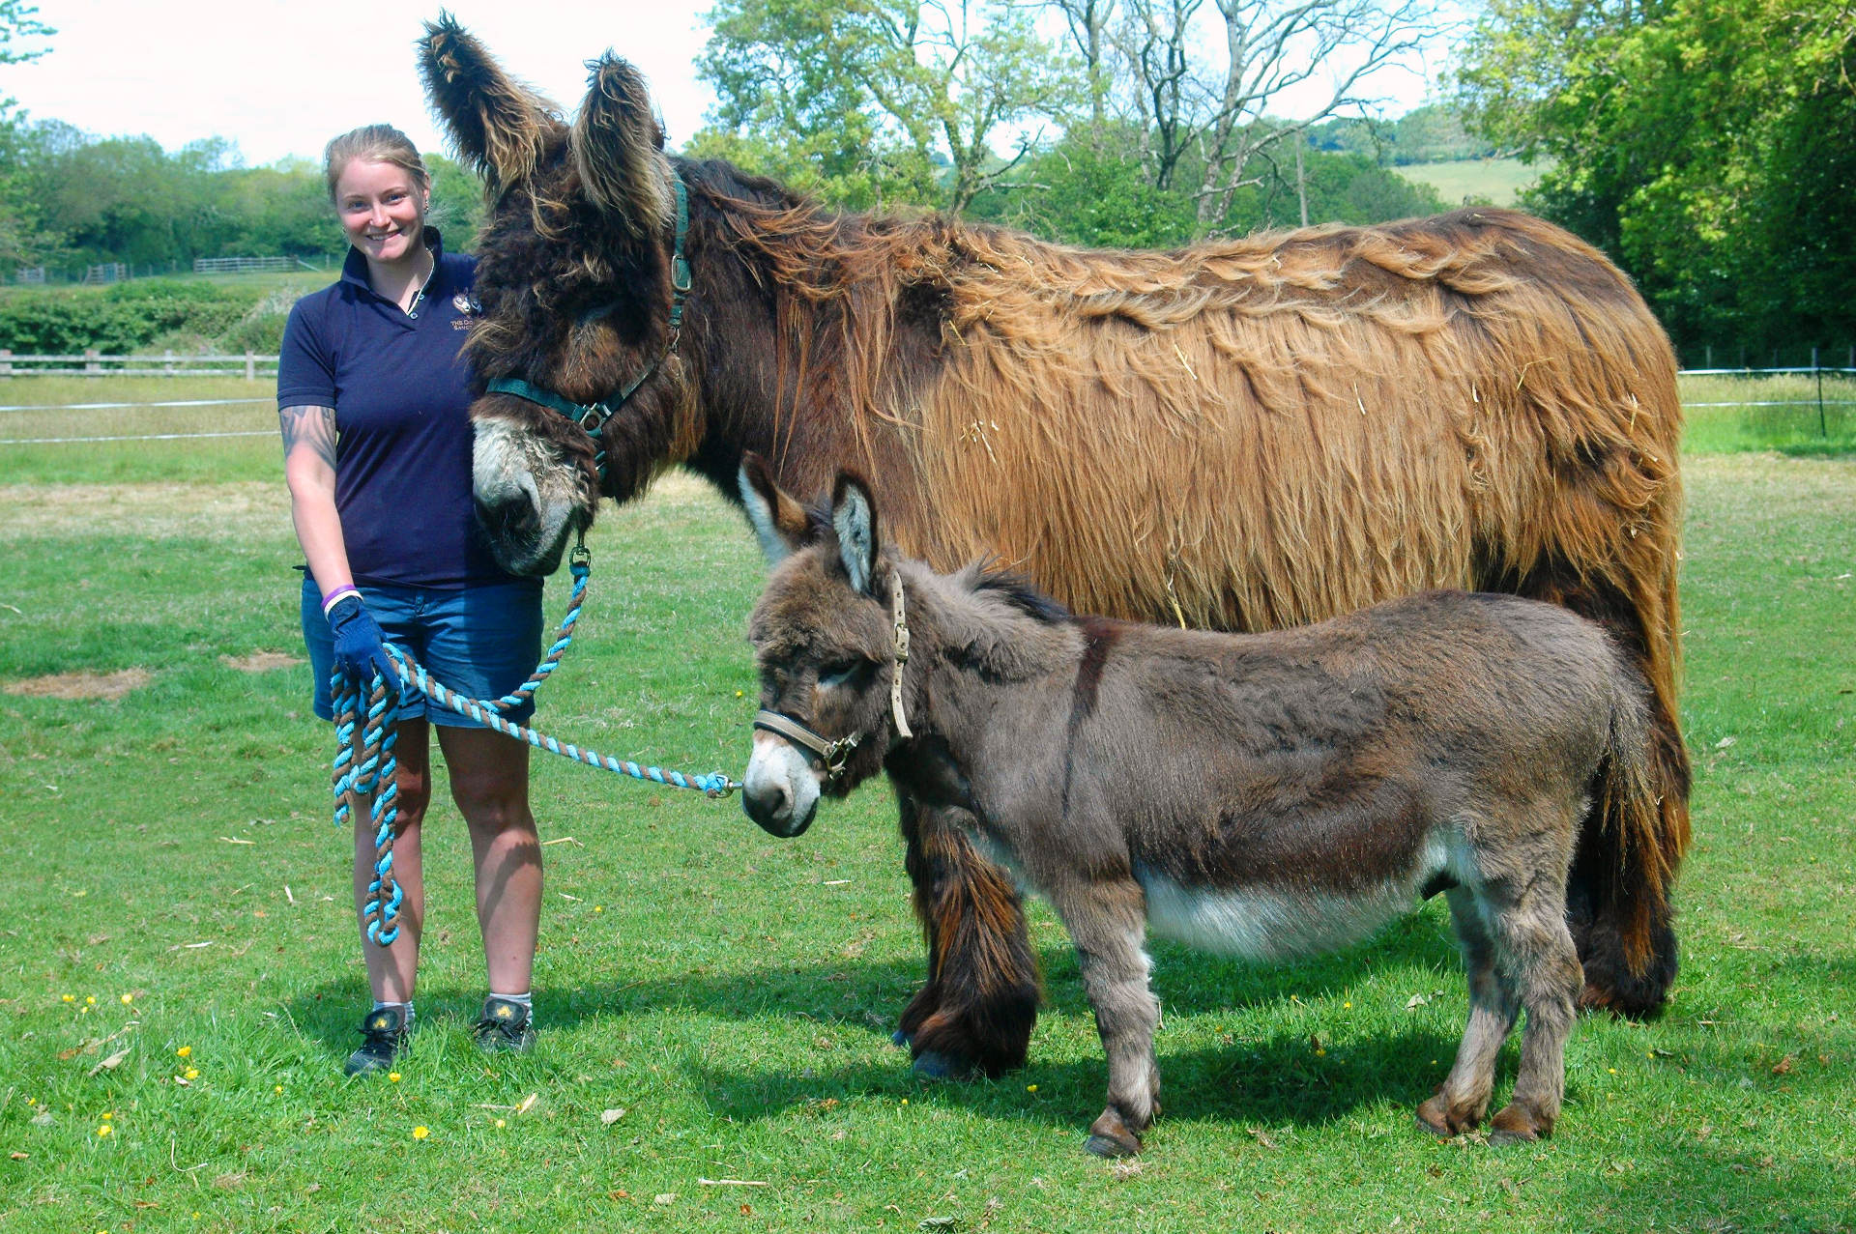

Slide 4
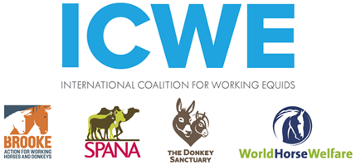


Slide 5
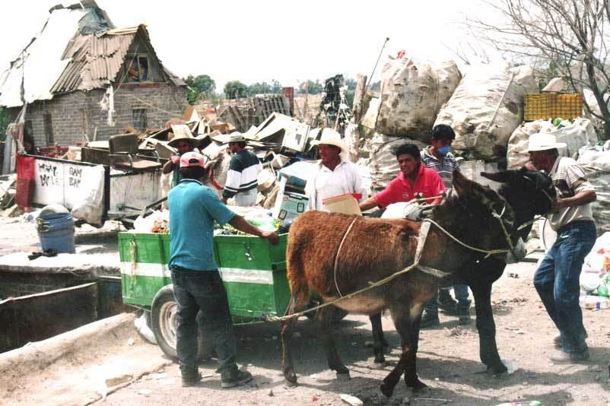

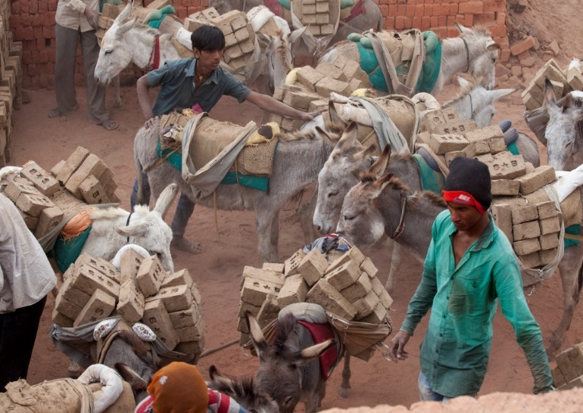
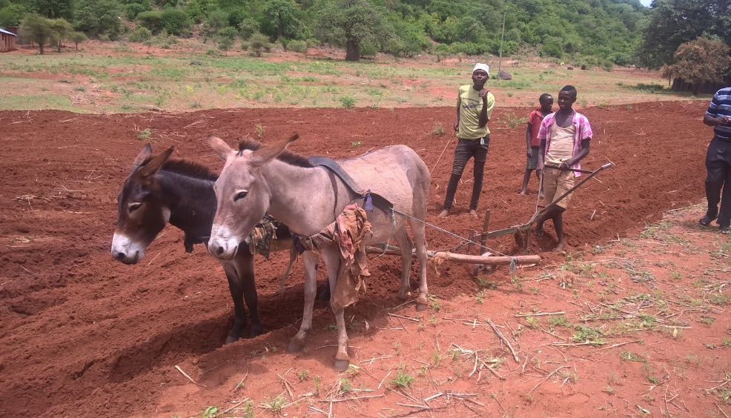
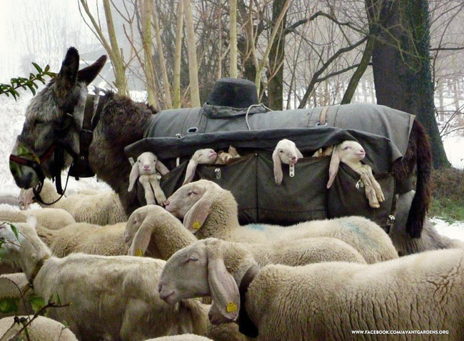
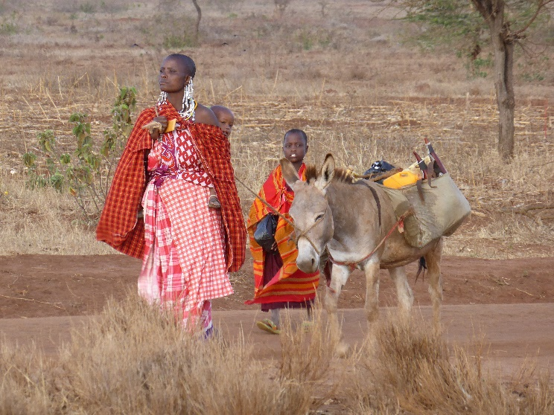
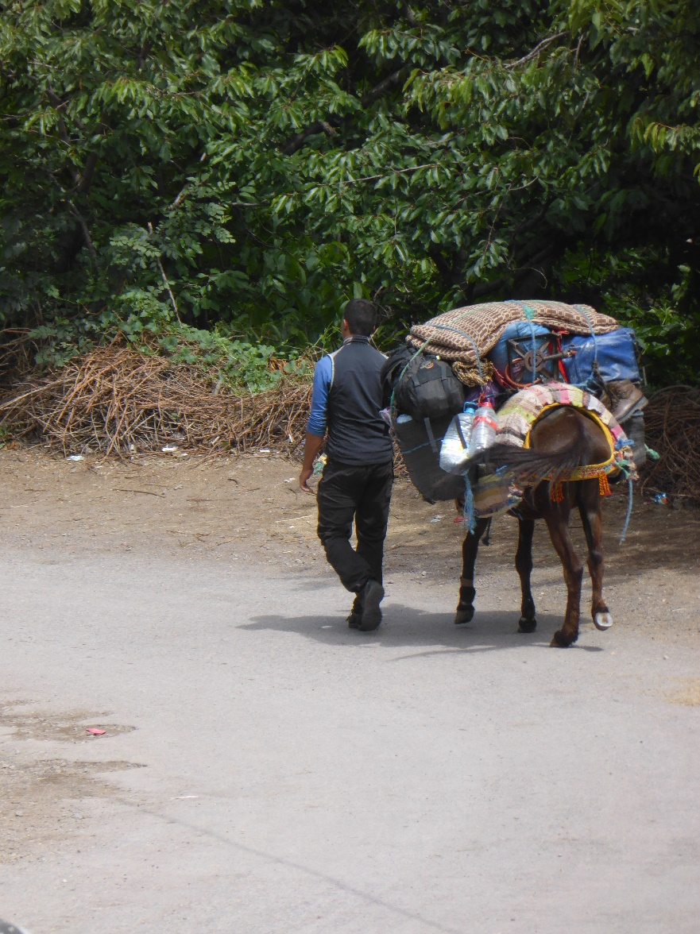
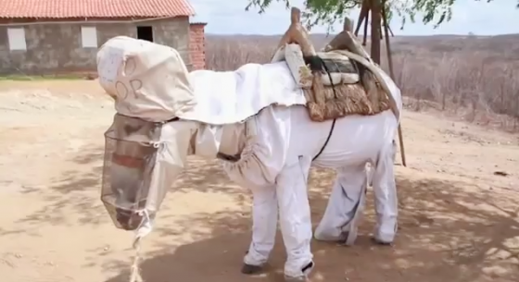
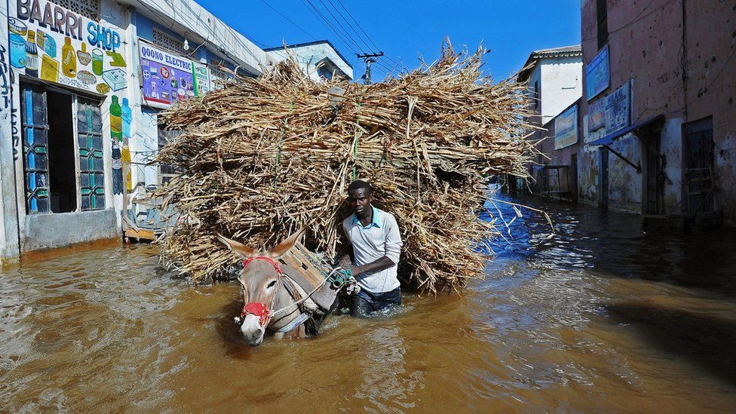
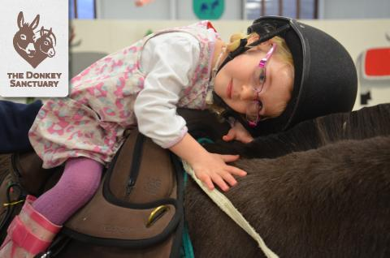
Notes:
So I just wanted to start today with a brief reminder of the diverse roles that working donkeys play around the world, supporting communities and the livelihoods of individuals.
From top-left to right: Rubbish collection carts in Kenya, construction sites in India, ploughs in Tanzania. Middle row left-to-right: sheep protecting donkeys of Romania, water collection of Tanzania, expedition mules in Morocco. Bottom left-to-right: beekeeping donkey of Brazil, droughts of Somalia, DAT in UK….

Slide 6

Working Equids Deliver Sustainable Development
Notes:
This struggle to find enough supply is impacting on the industry.
This chart shows the share value of China’s biggest ejiao manufacturer, Dong-e ejiao. Years of growth when supply was plentiful but in 2016, with the halting of sales by a number of Ecowass nations, and also the wider impact of unsustainable offtake globally, the industry just isn’t as profitable any more.
The industry started to charge more for the product as it had less to sell – it raised the price to nearly 40 times what it was in 2006. But it hit a ceiling, consumers refused to pay more for less and their profits have reduced by huge amounts.
Finding supply will only get harder but that also means that traders will cast their net wider, meaning that more remote, vulnerable donkey-dependent communities will alos be at risk. Just this week we have heard that, for the first time, communities in Zambia are being targeted by traders and thefts have started

Slide 7
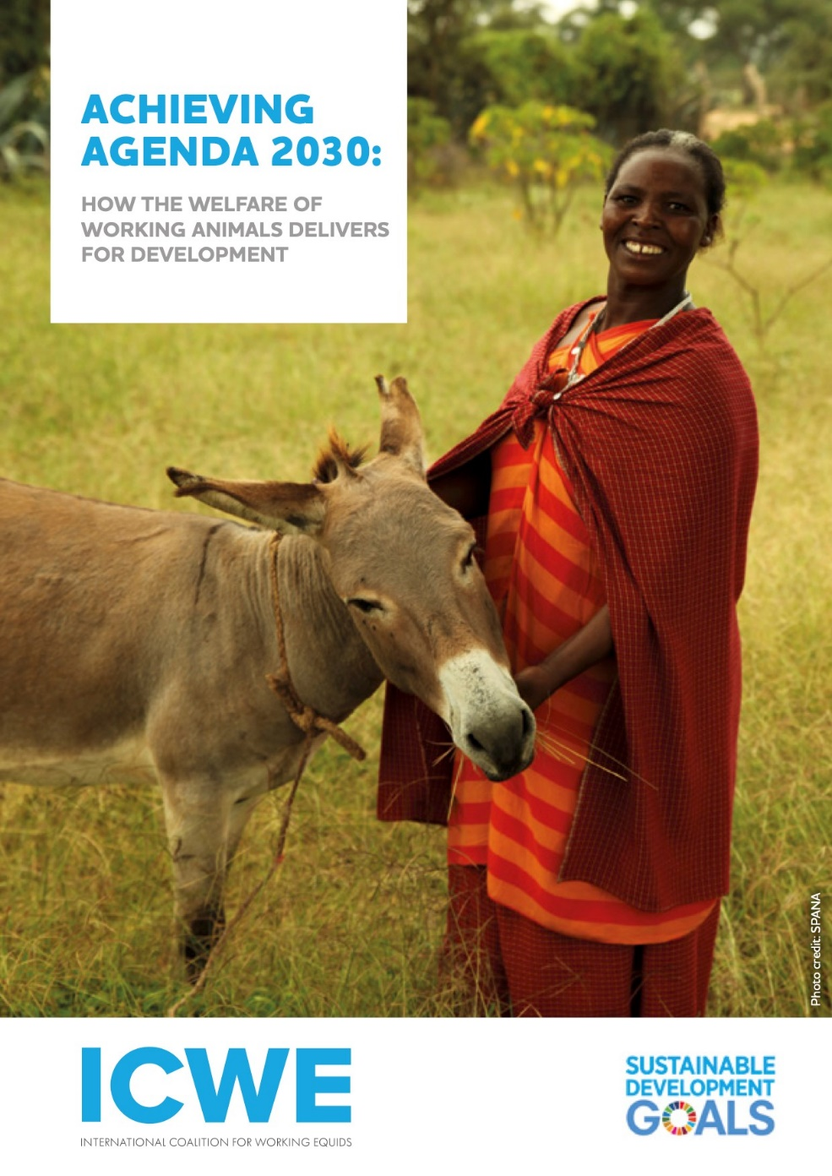
www.icweworkingequids.org

Slide 8
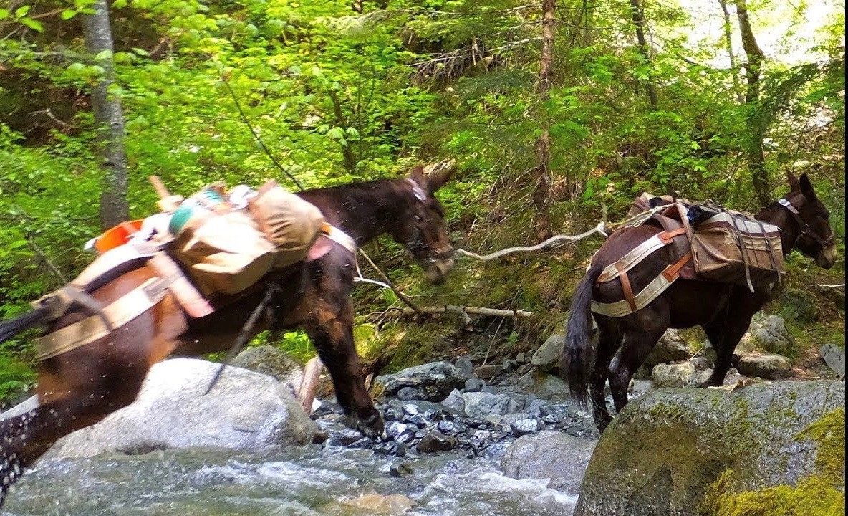

Slide 9
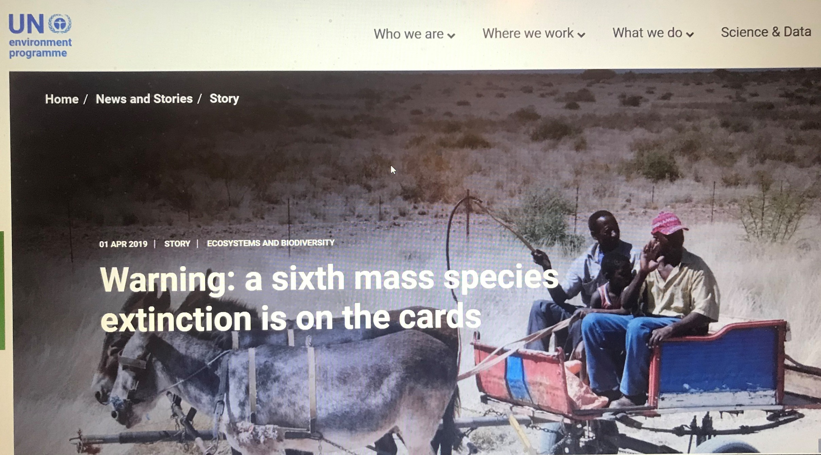
UNEP – The true value of donkeys?
Notes:
This struggle to find enough supply is impacting on the industry.
This chart shows the share value of China’s biggest ejiao manufacturer, Dong-e ejiao. Years of growth when supply was plentiful but in 2016, with the halting of sales by a number of Ecowass nations, and also the wider impact of unsustainable offtake globally, the industry just isn’t as profitable any more.
The industry started to charge more for the product as it had less to sell – it raised the price to nearly 40 times what it was in 2006. But it hit a ceiling, consumers refused to pay more for less and their profits have reduced by huge amounts.
Finding supply will only get harder but that also means that traders will cast their net wider, meaning that more remote, vulnerable donkey-dependent communities will alos be at risk. Just this week we have heard that, for the first time, communities in Zambia are being targeted by traders and thefts have started

Slide 10

UN Environment
‘But if the donkey leather is sourced from developing countries with weak environmental laws, what is the socio-economic and environmental impact?
The unsustainable extraction of a resource, whether it’s donkeys, plants, trees or minerals, can have adverse effects on the environment and communities in distant lands. In the case of donkeys, a valuable mode of all-weather, carbon neutral transport is removed from those most in need of transport in remote rural settings’.
Notes:
UN Environment have recognised the damage that can be done from the unsustainable offtake of any resource, in whatever form that takes. And in demonstrating that point, they have singled out donkeys as a specific example.
In the same month, the OIE warned that the “global donkey population is now at risk” due to the trade. The World Veterinary Association has called for a halt to the trade.

Slide 11
Notes:
But China had a problem, and it’s a problem that is getting bigger. The demand for ejiao was much greater than the available supply of donkeys in China.
China used to have the world largest population of donkeys – 11 million – But farmers switched to more low-input, high-output animals such as pigs and chickens. And so China’s donkey population, right now, may be as low as 2.6 million. That’s a 76% drop from 1992.

Slide 12

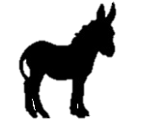
A Crisis Facing the Global Donkey Herd
50 MILLION
1.8 MILLION
3 MILLION
Notes:
Lets put that into context. 50 million donkeys in the world, and the ejiao industry takes nearly 5 million out of that figure every year, and has probably done so for the past 4 or 5 years.
Donkeys from China’s shrinking donkey population account for 1.8 million of that, and possibly less. The rest – 3 million every year, and probably many more than that, come from outside China, and the majority of those from Africa.
The ejiao industry is now facing a crisis of supply. With a growing number of countries closing supply routes, including those with large donkey populations such as Ethiopia and Nigeria, there are simply not enough donkeys to sustain the trade.
Industry representatives are very worried about the increasing shortage of donkey skins – their efforts to meet demand from their farms in China have not borne fruit, despite the investment of hundreds of millions of dollars.

Slide 13
Sourcing Donkey Skins for China
Asia
Europe
North America
Middle East
Atlantic Ocean
Africa
Pacific Ocean
Australia
South America
Notes:
All these source countries are supplying skins to China. This is where the 3 million skins annually are coming from, although we know that skins and donkeys are being traded and exported illegally and in defiance of national export bans from a number of other countries.
So that 3 million should be the lowest figure that we work to.

Slide 14
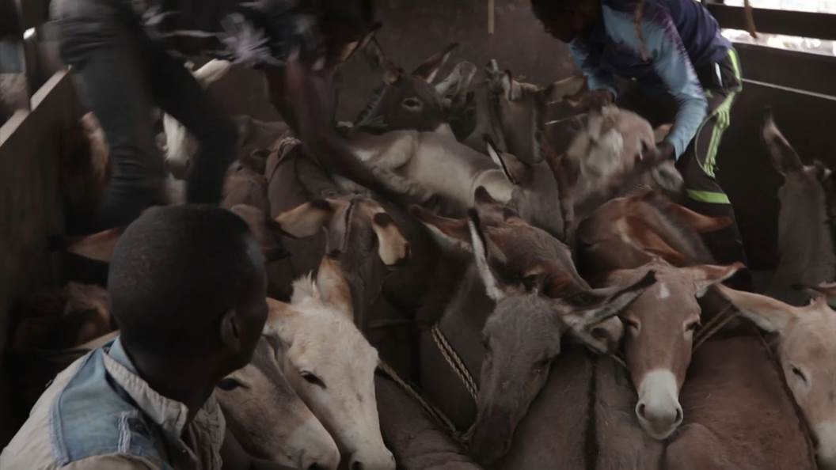
Welfare Compromises
Poor transport over long distances
Money driving numbers – indiscriminate use of donkeys
Unskilled labour – poor handling and bad slaughter
Inhumane practices – slaughtered carcasses piled up next to donkeys penned next to slaughterhouses
Notes:
And this is what’s causing this threat. Ejiao is a traditional Chinese remedy or tonic made from donkey hides that have been boiled and processed and once the collagen is extracted and mixed with herbs here is the end result. A slab of ejiao and this would probably set you back several hundred dollars.
Its bought mainly by women in China, who use it as a blood purifying tonic and although for many years consumers had forgotten about it, some clever marketing changed all that and it became a product everyone wanted to buy.

Slide 15


Slide 16
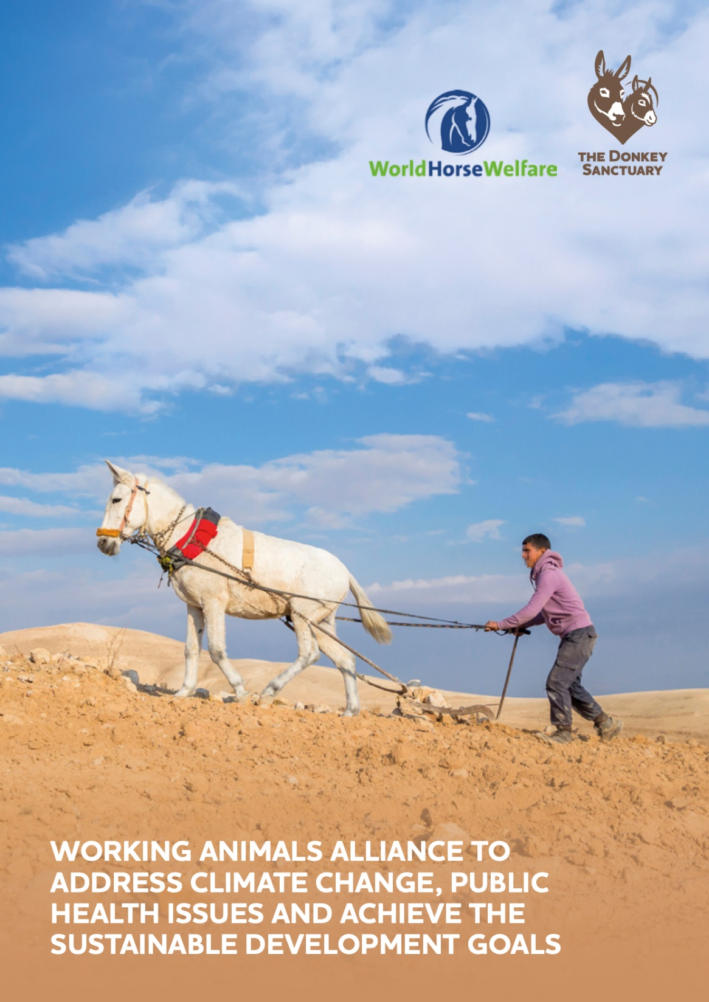
Working Animals Alliance
ian.cawsey@thedonkeysanctuary.org.uk

Slide 17
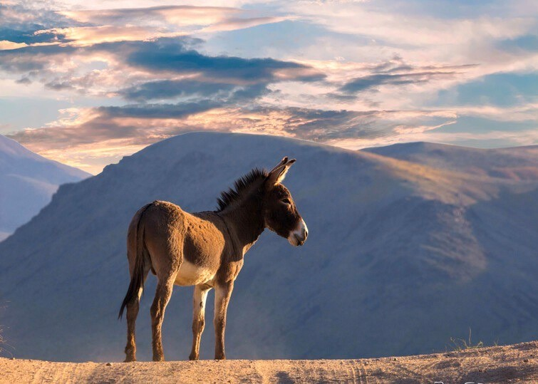
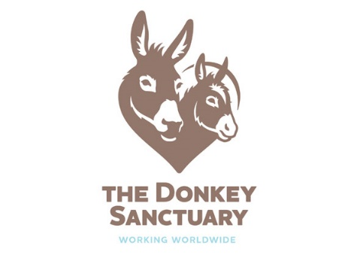
Thank You!
ian.cawsey@thedonkeysanctuary.org.uk

