Slide 1
The trade in donkeys and their skins:
a risk to global health
Dr Linda Evans BVetMed MRCVS
November 2021

Slide 2
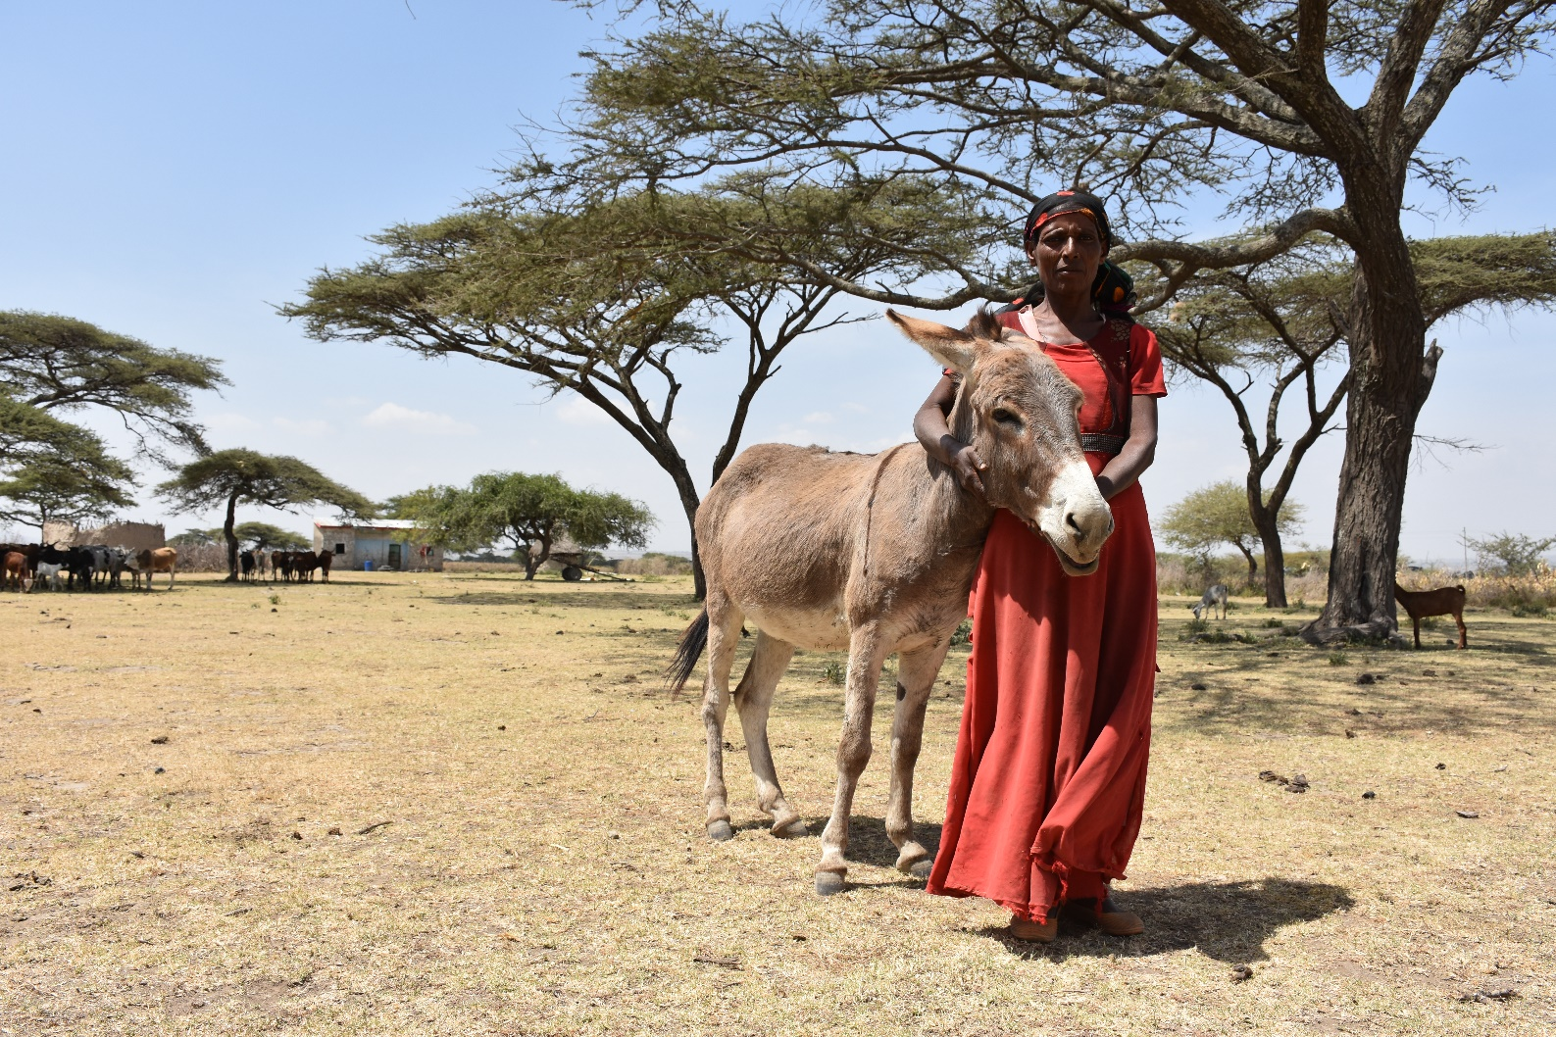
This pandemic has shown us that we must pay attention to One Health One Welfare and to the inextricable links between people, animals and the environment.
Mass movements, whether people, domesticated animals or wildlife, will always bring with it a risk to transmission and escalation of disease.
Moving forward we must be alert to global movement and its impact; and apply the concepts of One Health One Welfare.
Notes:
Donkeys are recognised as being difficult to detect as suffering ill health

Slide 3
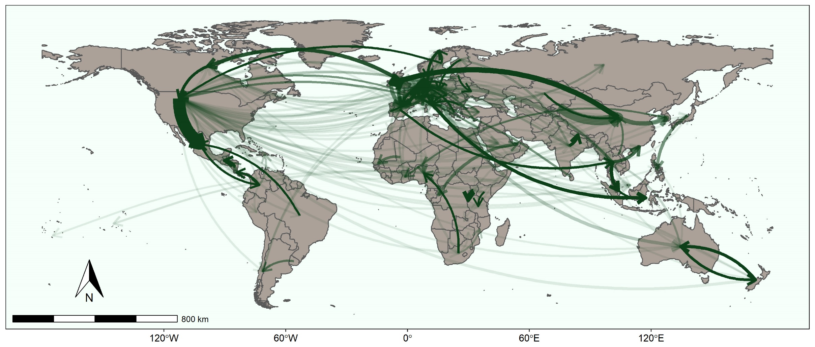
Global Movement
Trade in live donkeys 2012-19
Taken from: UN Commtrade dataset using category for Ass
Notes:
Caveats are that this data appears to include some movements of sports horses even though the code is specific for the Ass.
It will under-record live donkey movements – unlikely to be on this dataset if walked across continents or if moved illegally for slaughter for skins.

Slide 4
Why the movements?
Ejiao is a traditional Chinese medicine.
The main ingredient is collagen from donkey skin:
The demand far outstrips the supply
The diminishing number of donkeys in China can only supply a small percentage of the demand
In order to source skins for this product there is:
widespread movement of live donkeys within continents
a global trade in skins
emergence of intensive donkey farms and collection units for donkeys destined for slaughter.

Slide 5
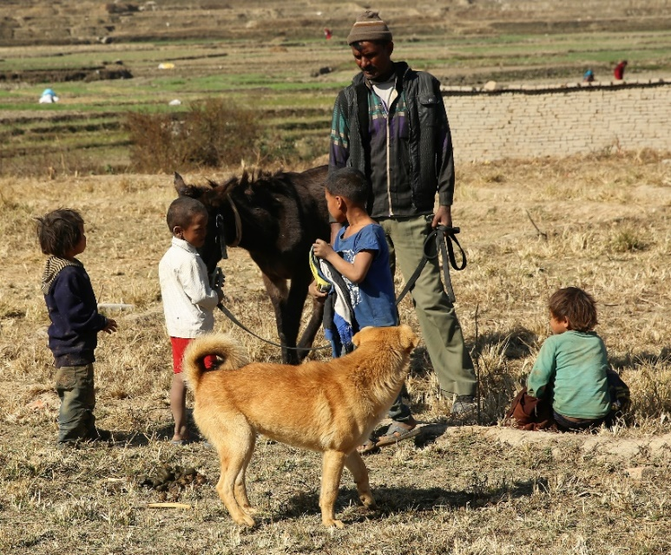
What are the risks?
Mass movement over long distances and across borders.
A species with acknowledged issues in showing signs of ill health.
Transport often compromises welfare, with ill health at outset or escalated as a result of journeys.
Alongside poor biosecurity practices this equates a disaster to global disease spread
Threats to public health and the food chain by lack of traceability and associated risks from residues
The resulting impact is to:
the health of people
livelihoods and country economy
the environment.
Notes:
No incentive to provide good welfare or food and water because animals are destined for slaughter. Meat quality is possibly irrelevant.
Poor welfare due to transport in unacceptable conditions, long journeys, stress of mixing animals, intensive farming.
Lack of biosecurity – during transport, mixing groups of animals. Unsanitary conditions for slaughter and treatment of products. Lack of ante-mortem identification of disease
Traceability without ID and central recording system – but large scale mixing limits any benefits from traceability with regard to disease spread.
Residues – not accountable, no traceability

Slide 6
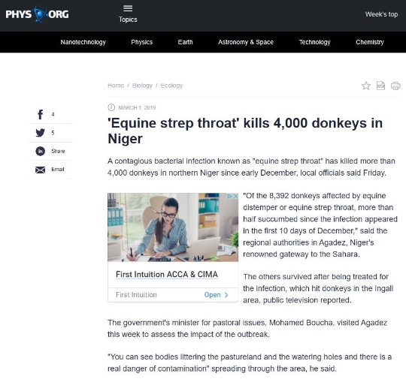
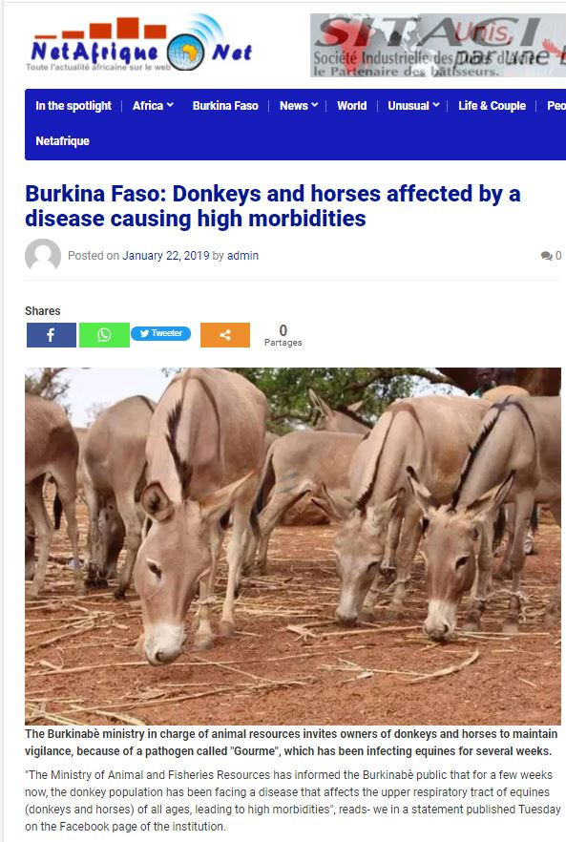
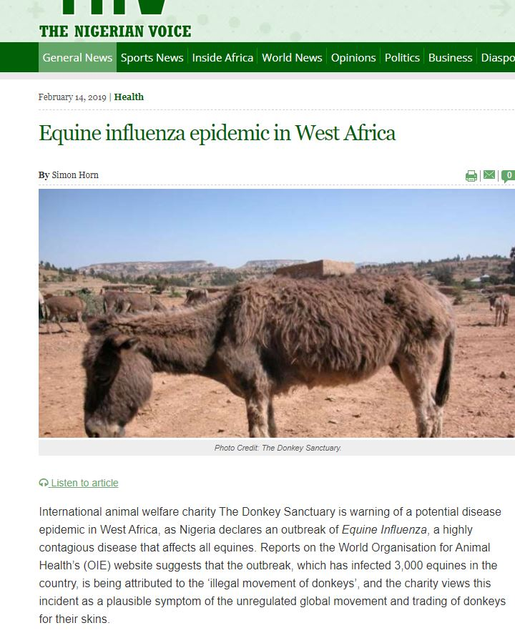
The trade in live donkeys
Common reasons for the large scale trade are:
to other countries for the purpose of slaughter for skins
within countries for the purpose of slaughter
to populate new or expanding farms
Transport, movements and distances result in:
a risk to escalation of disease
a risk to transmission of disease along the route
Consider the loss of equids across West Africa in 2019
Notes:
Stress, exhaustion, poor welfare and mixing groups of donkeys from unknown disease status is going to result in poor health – escalation of disease.
Disease outbreaks in countries – risk to welfare to animal population and to economy
Costs of outbreak control/loss of trade/costs of eradication and return to disease free status

Slide 7
Global Movement
Trade in live donkeys 2012-19
Notes:
Reminder -Look at distances travelled
Borders crossed and compare with previous map of endemic disease
Even if some of these are sports horses – remember the risk of spreading diseases of equids to this population – and the implications to what is a lucrative industry.

Slide 8
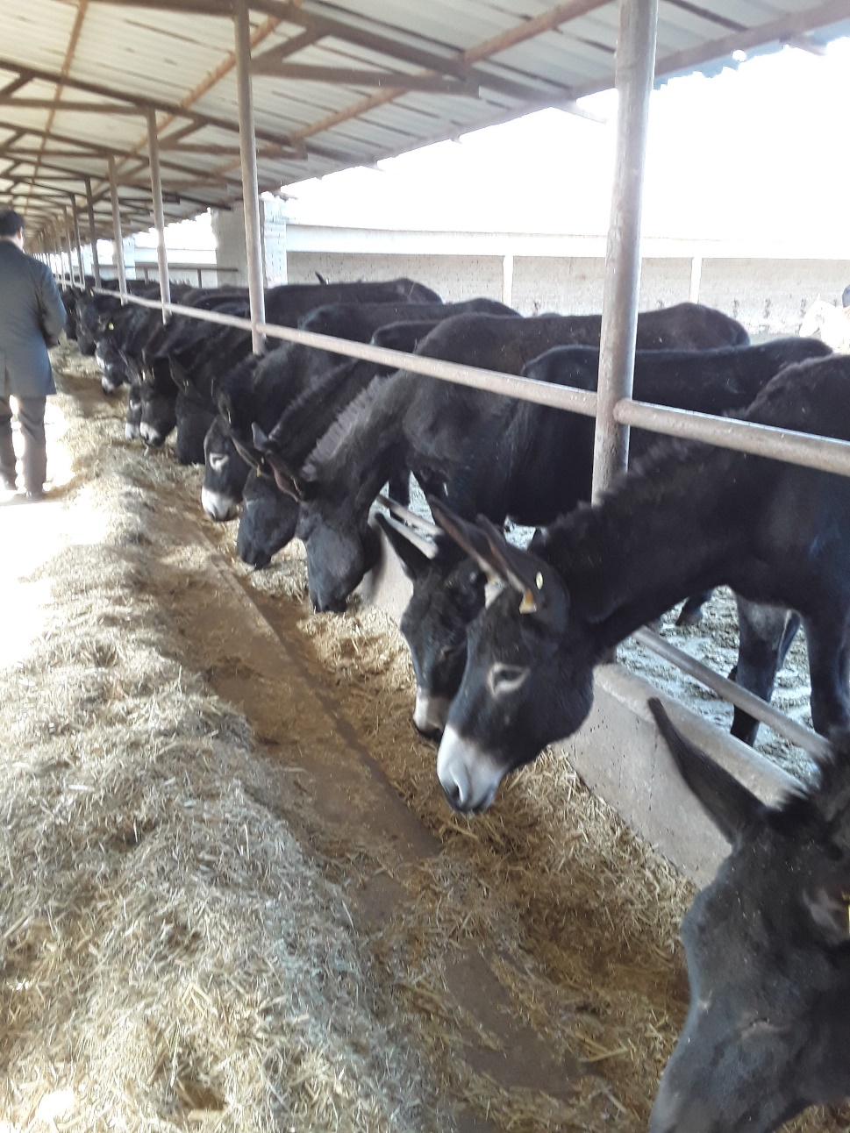
Farming of donkeys
Expansion of farming with intensive farms and
Collection sites where donkeys are transported long distances and then held in readiness for slaughter
Biosecurity may not be effective, any disease introduced to these premises is likely to:
go unnoticed in the donkey, especially with the numbers present
amplify at a rate that will quickly become out of control
Notes:
Intensive farms = large numbers 3,000 or more

Slide 9
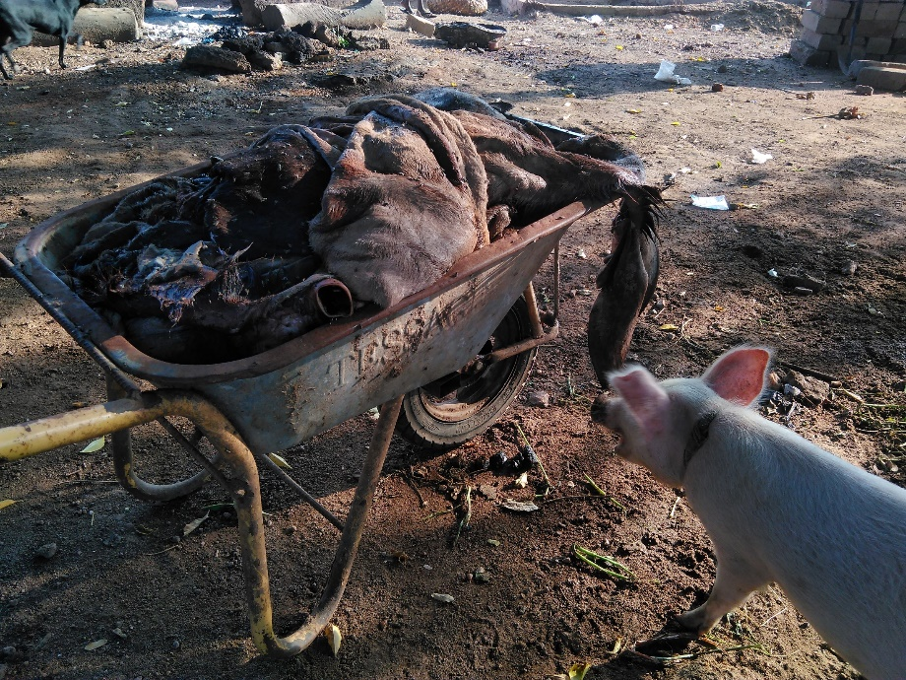
The trade in skins
Risk mitigation is reliant on:
Recognition and diagnosis of ill health
Effective ante-mortem inspection
Sanitary conditions for slaughter
Effective treatment and preservation of skins .
What is the risk:
Carrying infectious agents; both equid diseases and also other diseases
Carrying infected vectors in consignments
Transmitting disease across borders
This is a global problem

Slide 10
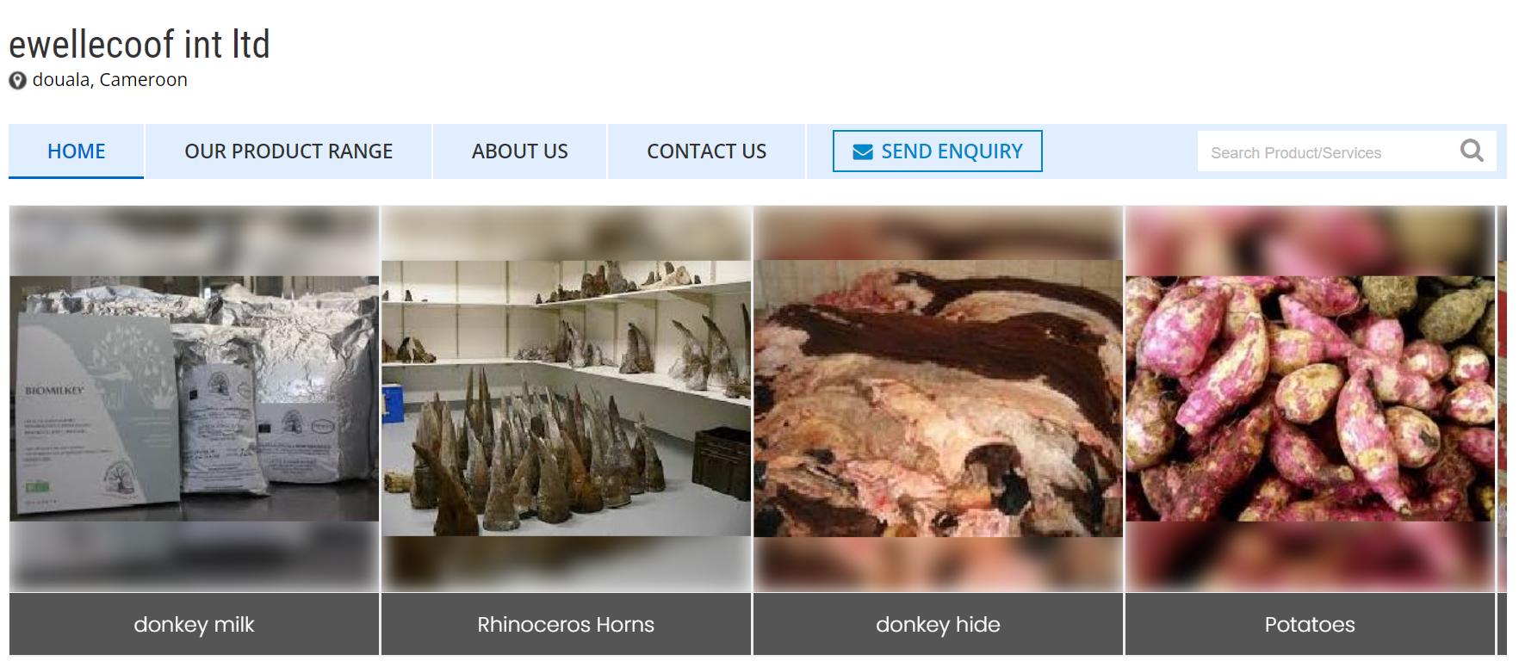
A Convergence of Criminality
Co-Sales of items from illegal wildlife trade
Traders and the channels they use are also involved in people trafficking and sales of drugs
Business to business sites are used by criminals to trade
Undermining national efforts to protect their working equid population
Nigeria, 2018 – Co-seizure of donkey skin, ivory and Pangolin
Sites offering donkey skins, rhino horn and potatoes for sale
At a time when we are looking closely at disease transmission and links between domesticated animals, wildlife and man we need to act quickly.
We need to shut down these routes.
Notes:
With the risks already discussed we now have an added threat with the unregulated movement of wildlife products.
It has become evident that donkey skins are being offered for sale online alongside CITES Appendix 1 wildlife items such as Ivory, Rhino Horn and Pangolin. There is clear and worrying evidence of links between the donkey skin trade and more organised criminality, even individuals involved in people trafficking.
In the picture at the top is a newspaper report from Nigeria – a seizure by customs authorities in 2018 of 23 bags of Pangolin Scales, 8 bags of elephant ivory and 99 bags of donkey skins, all destined for China.
One of the main platforms being used to offer these co-sales of donkey skins, drugs, and wildlife items are so-called B2B sites – Business to Business – where a trader in a source country can offer items up to the global marketplace. And the image at the bottom is from just one of these sites – a trader based in Douala in Cameroon has donkey skins being offered for sale alongside Potatoes and Rhino Horn.
Many of these traders are based in countries with a ban on the slaughter of donkeys and the export of their skins. And yet we have clear evidence of shipping companies taking consignments of skins from these countries, a number of which are in West Africa, and therefore undermining those national efforts to preserve donkeys herds for the benefit of their people.

Slide 11
What is the future?
We must consider the impact to One health. One welfare
What will the effect be on families and communities; the risk to livelihoods?
If we decimate populations what will this do to the environment, what will replace the donkey in the community?
Are the risks to global disease acceptable; consider the economics and further risks to animal populations?
Are the risks to public health acceptable if we allow this to continue as it is?
Notes:
I’ll leave you with a thought – should we be asking TCM to consider laboratory grown collagen as a solution?

Slide 12
Thank you for listening

